Slide 1
Deepfakes
https://www.youtube.com/watch?v=BU9YAHigNx8

Slide 2
CIS 700-004: Lecture 7W
GANs
02/27/19
Notes:
Done

Slide 3
Today's Agenda
Project overview
Review of VAEs
Adversarial examples
GANs
Generators, discriminators
The dual loss functions
Mode collapse
GANs in PyTorch
Types of GANs
Applications of GANs

Slide 4
Project overview

Slide 5
Review: variational autoencoders

Slide 6
Why use VAEs instead of simple autoencoders?

Slide 7
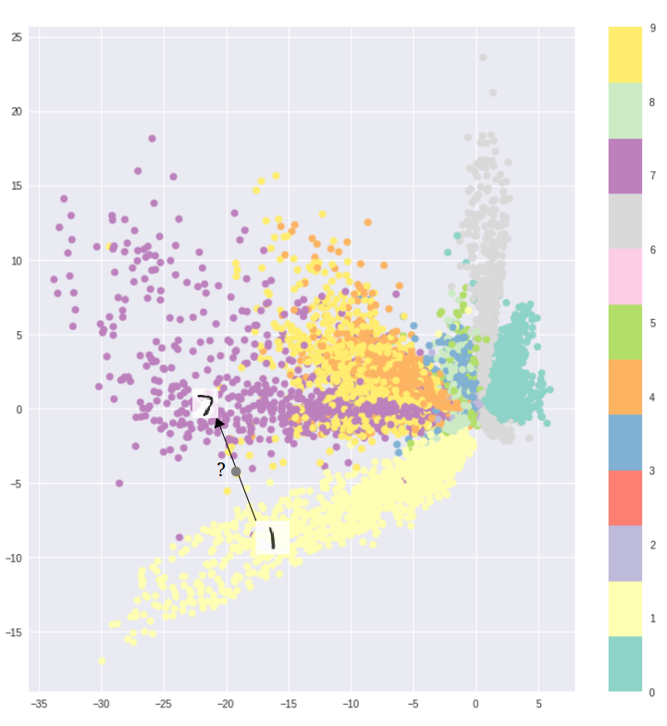
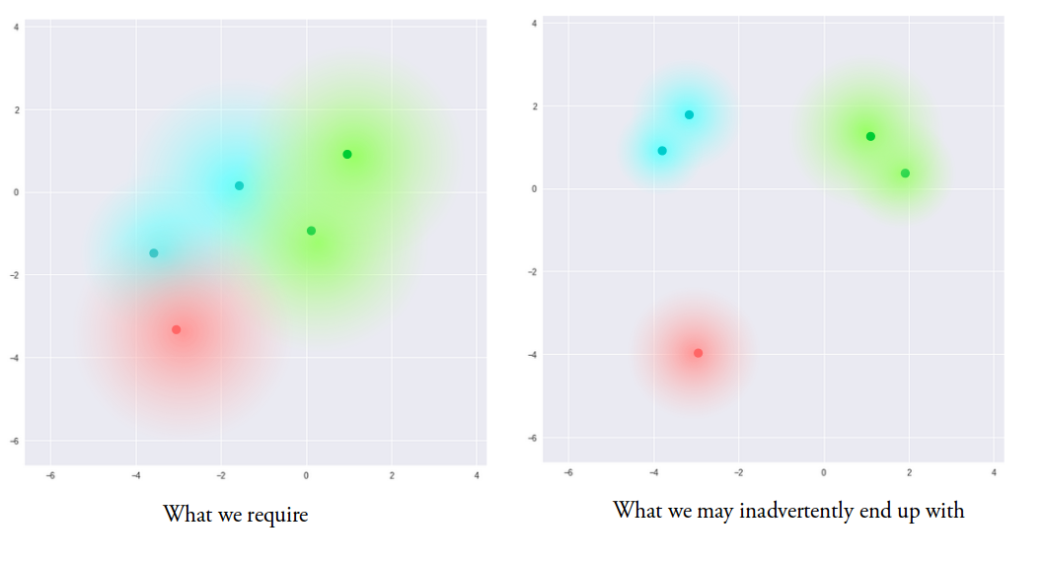
The empirical data distribution makes interpolation difficult.
Training using only reconstruction loss
Notes:
https://towardsdatascience.com/intuitively-understanding-variational-autoencoders-1bfe67eb5daf

Slide 8
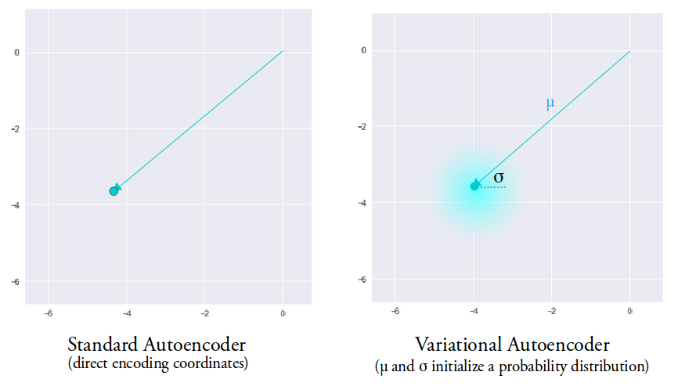
VAEs allow us to explore a fuller distribution of the data.
Notes:
https://towardsdatascience.com/intuitively-understanding-variational-autoencoders-1bfe67eb5daf

Slide 9
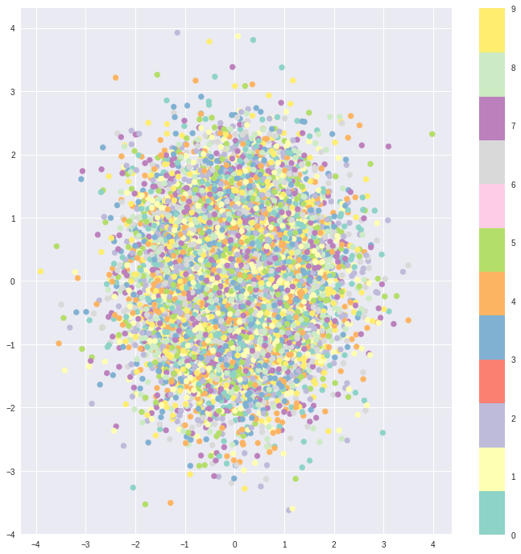
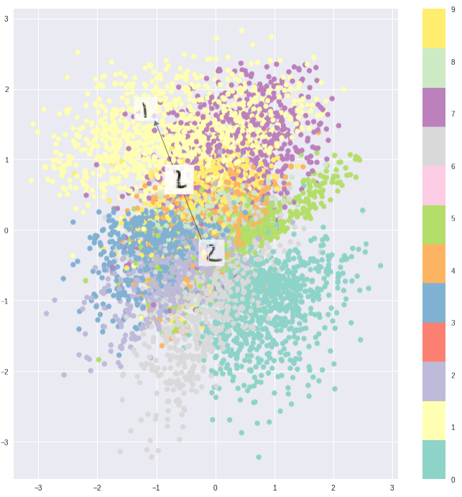
The result is better encoding over the whole feature space.
Reconstruction loss
KL divergence
VAE loss
Notes:
https://towardsdatascience.com/intuitively-understanding-variational-autoencoders-1bfe67eb5daf

Slide 10
We use VAEs to get a better featurization of the full input space by using the posterior distribution for exploration.

Slide 11
How do we accomplish this with an architecture?

Slide 12
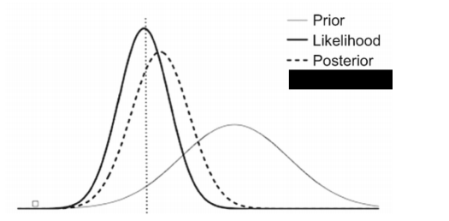
Bayesian posteriors

Slide 13
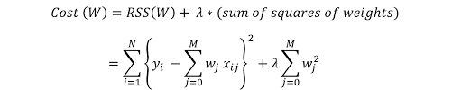

The VAE loss function, compared to ridge regression

Slide 14
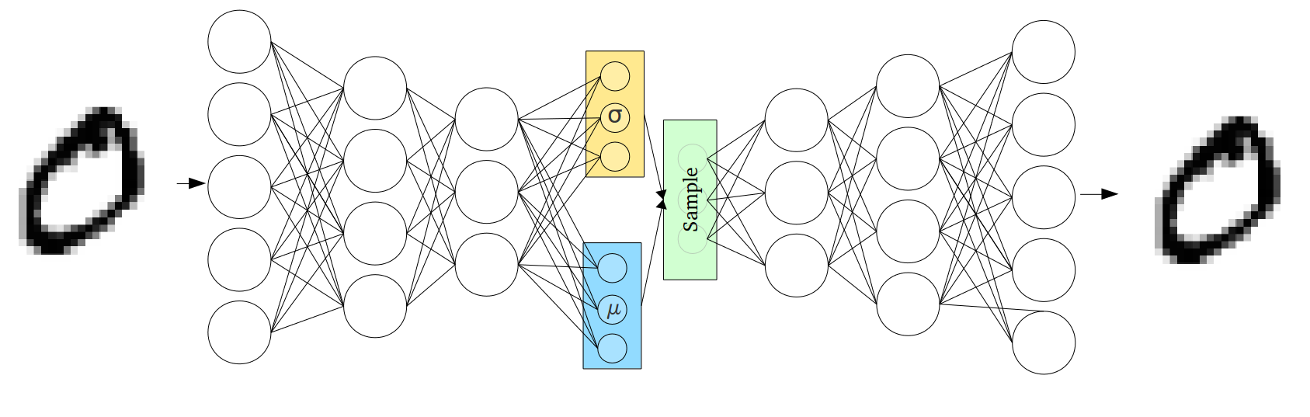
VAE estimates a posterior and samples from it.

Slide 15
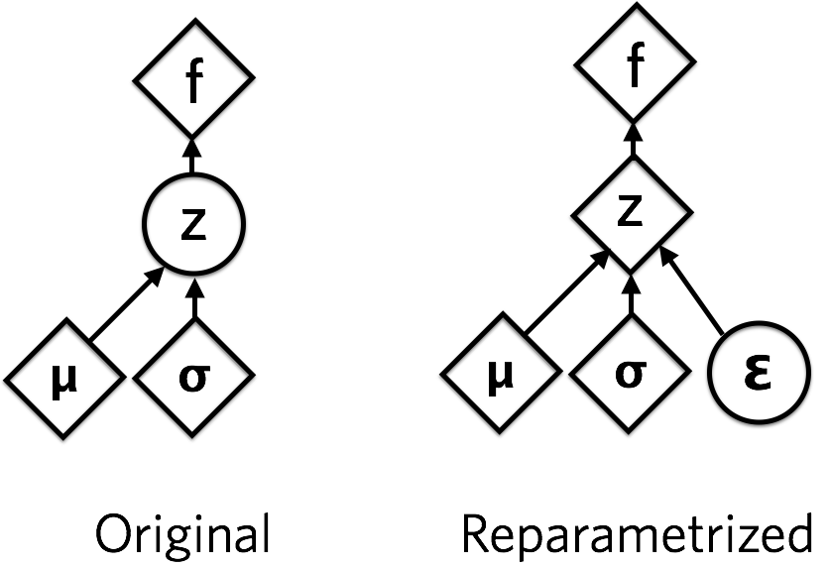
The reparametrization trick
Notes:
https://jaan.io/what-is-variational-autoencoder-vae-tutorial/

Slide 16
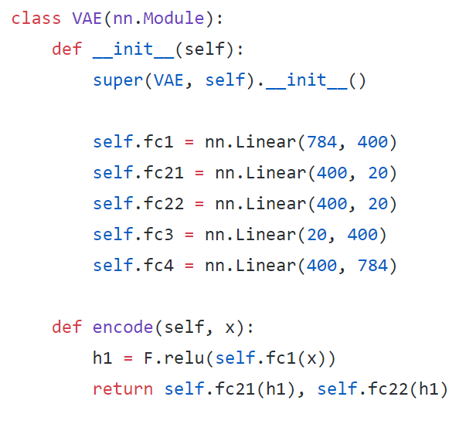
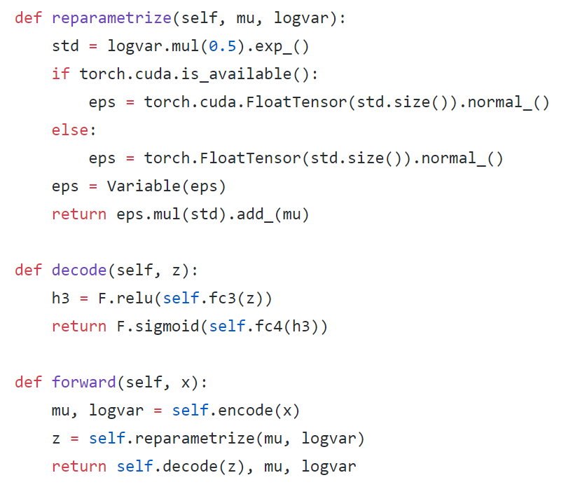
Variational autoencoders

Slide 17
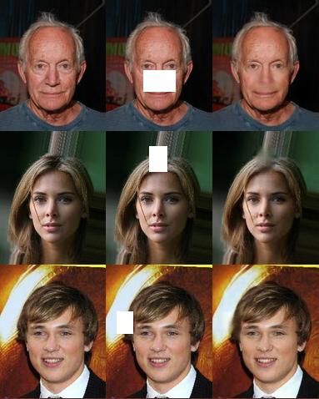
VAEs can complete images through the denoising process.

Slide 18
Adversarial examples
Notes:
Done

Slide 19
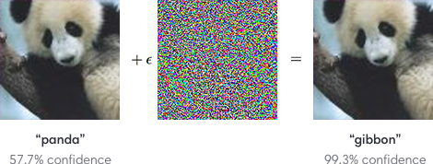
What is an adversarial example?
Notes:
Done

Slide 20
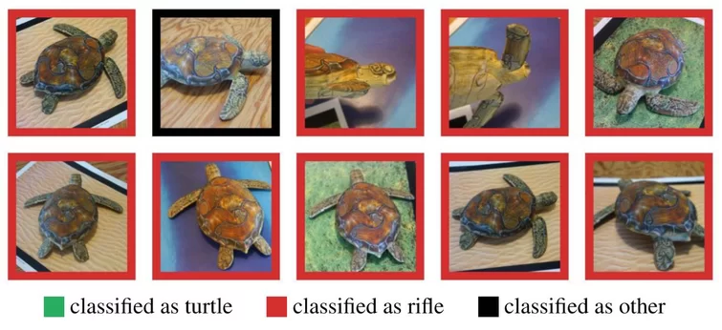
What is an adversarial example?
Notes:
Done

Slide 21
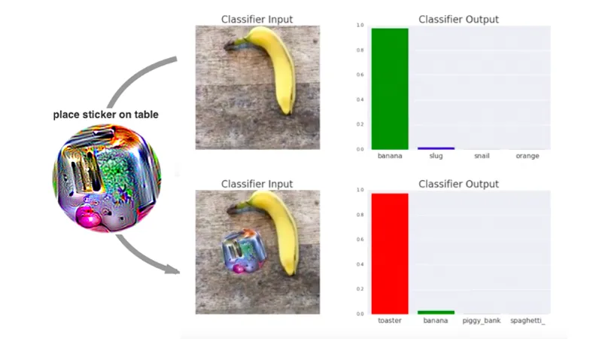
What is an adversarial example?
Notes:
Done

Slide 22
Are adversarial examples a bad thing?

Slide 23
Can we use them to our advantage?

Slide 24
Generative Adversarial Networks

Slide 25
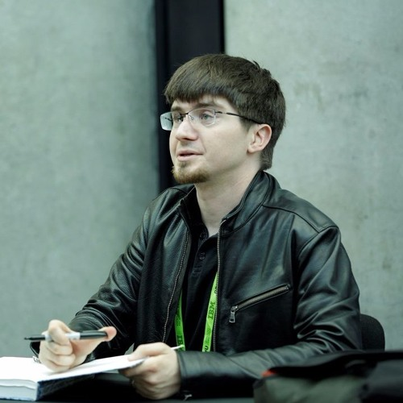
Ian Goodfellow
Wrote our textbook (Deep Learning) with his PhD advisor, Yoshua Bengio
Created GANs while at Google Brain
Part of the founding team at OpenAI

Slide 26

Generator and discriminator

Slide 27
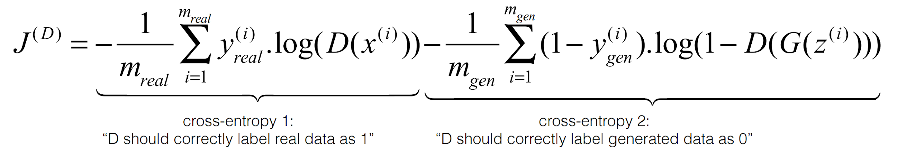
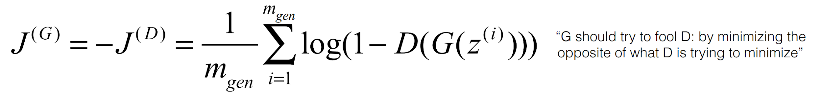
The dual loss functions (attempt 1)

Slide 28
This is a bad choice of loss for G. Why?

Slide 29
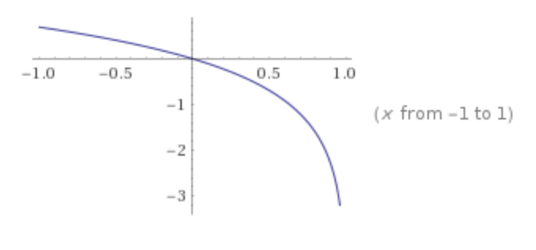
Why the naive generator loss has a saturation issue.
The function y=log(1-x)

Slide 30
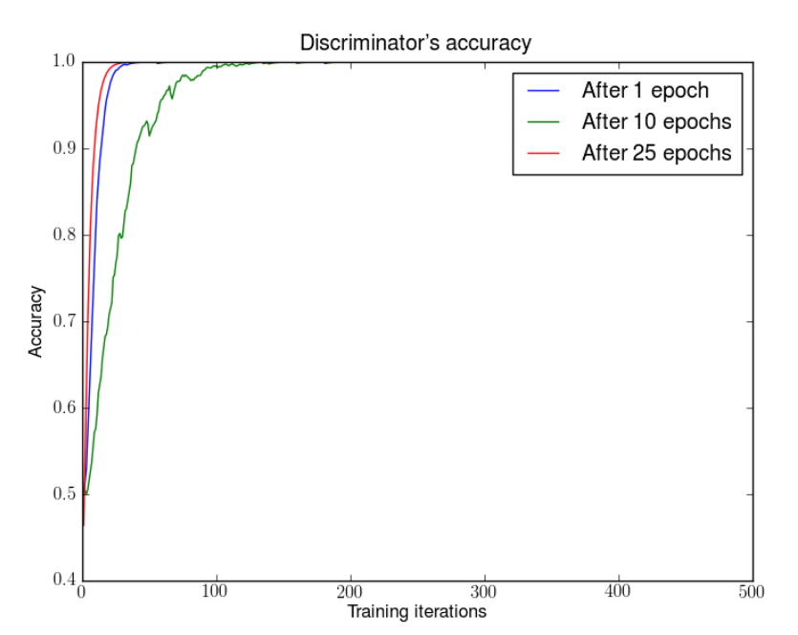
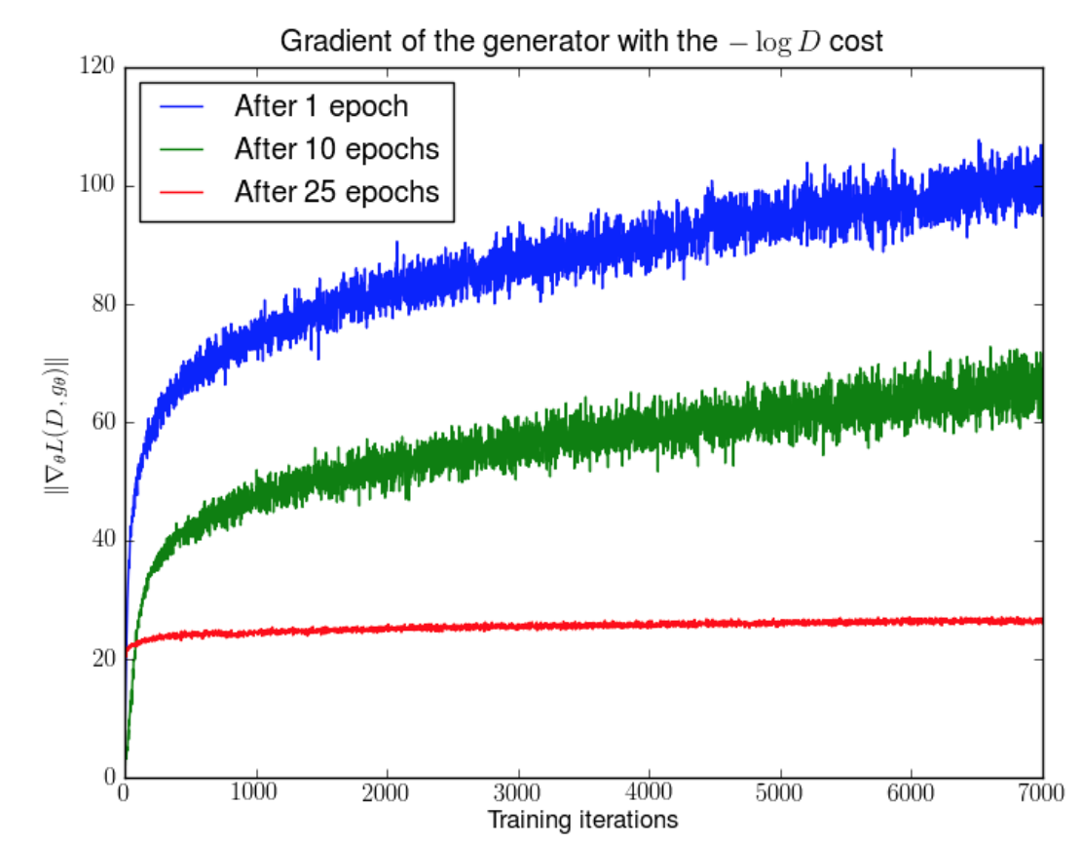
Why the naive generator loss has a saturation issue.
The function y=log(1-x)
Notes:
https://medium.com/@jonathan_hui/gan-what-is-wrong-with-the-gan-cost-function-6f594162ce01

Slide 31
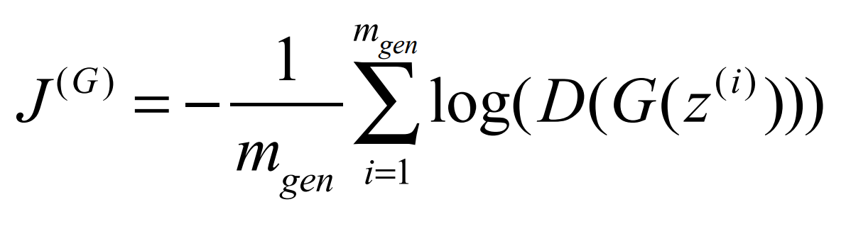
The dual loss functions (attempt 2)

Slide 32
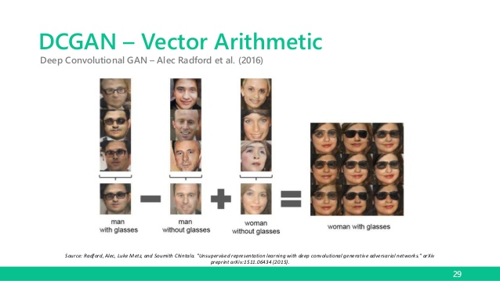
GAN representations form a semantic vector space.

Slide 33
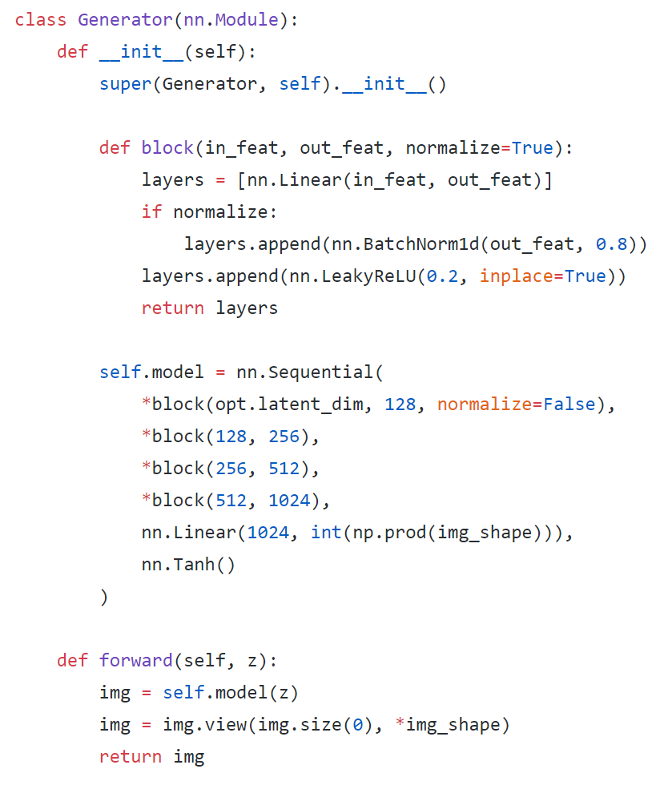
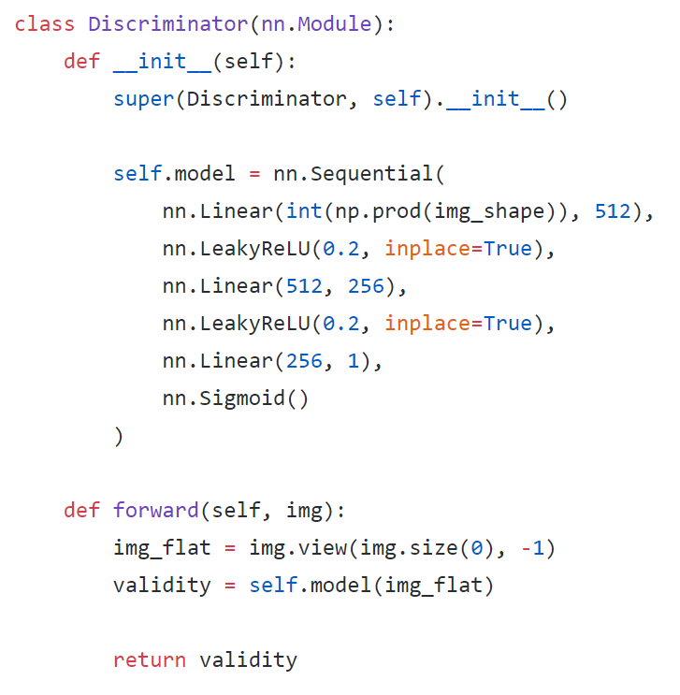
GANs in PyTorch: architecture

Slide 34
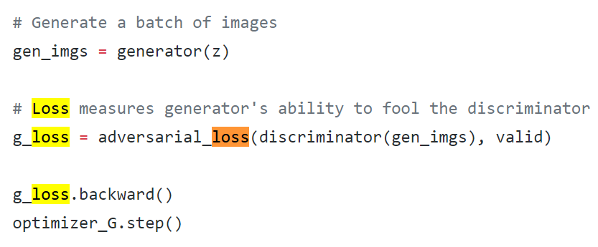
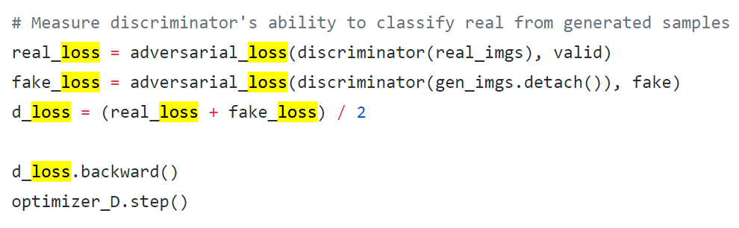
GANs in PyTorch: loss

Slide 35
Types of GANs

Slide 36
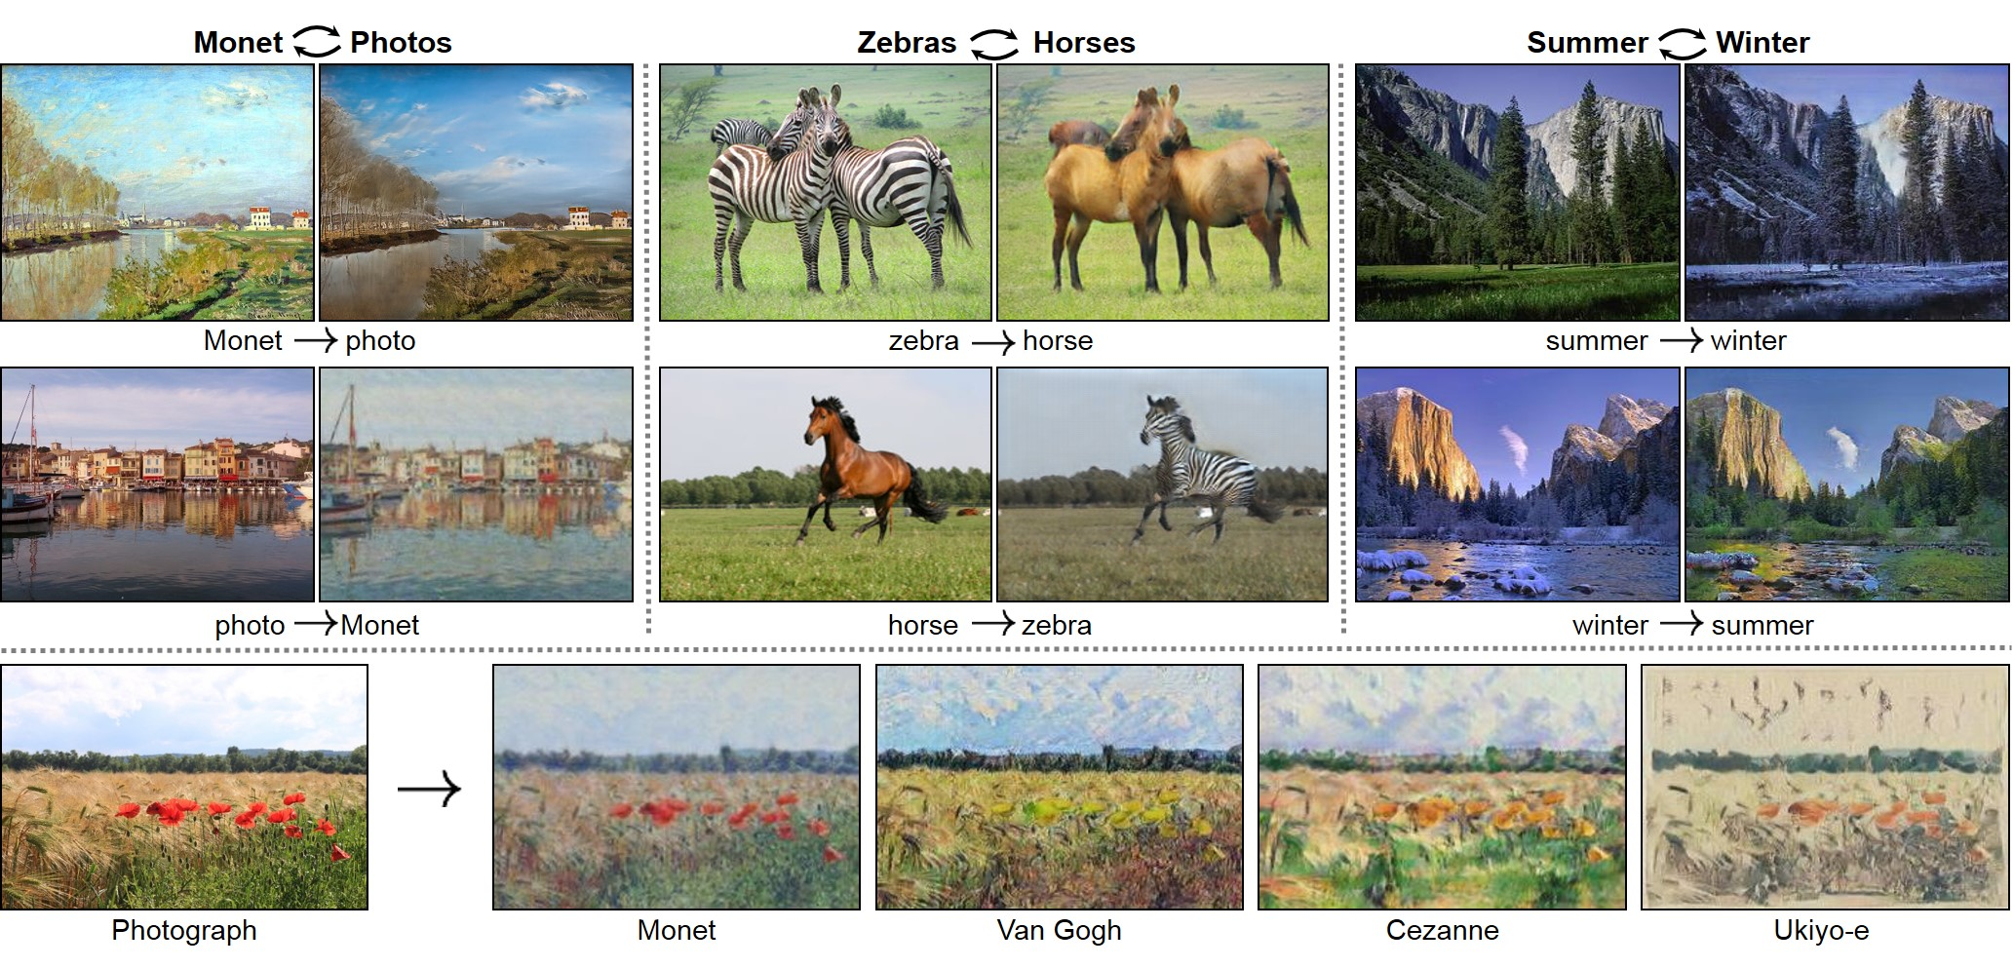
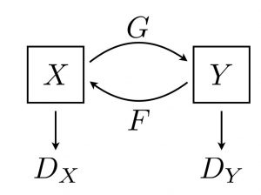
CycleGANs

Slide 37
CycleGANs

Slide 38
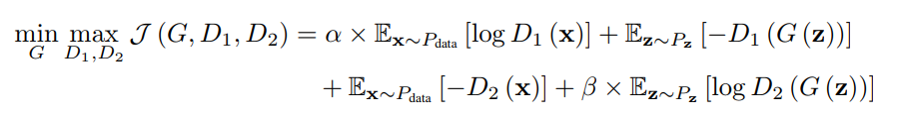
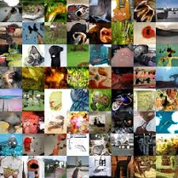
D2GAN

Slide 39
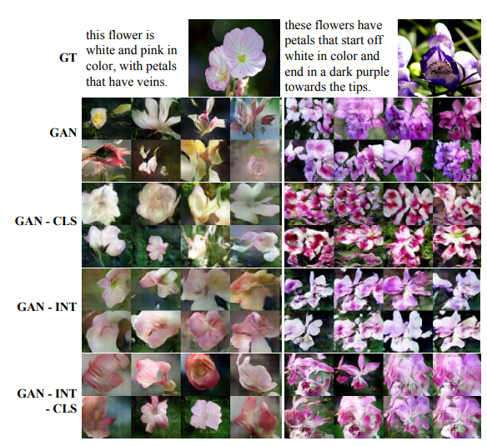
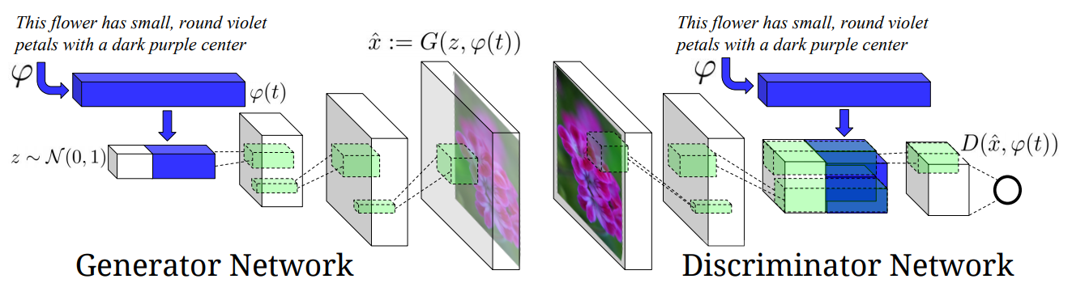
GATIS

Slide 40
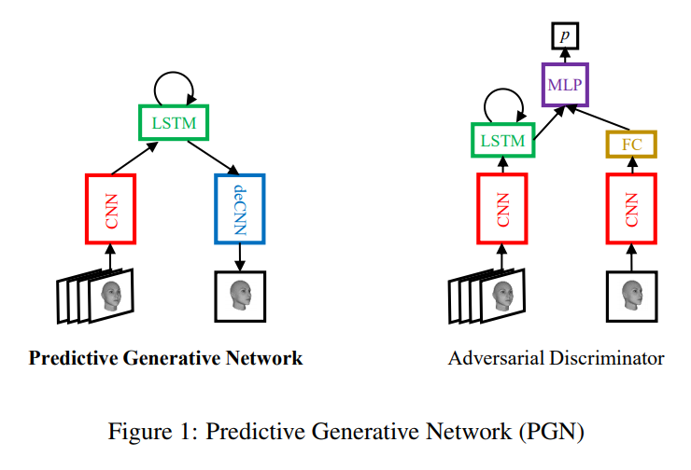
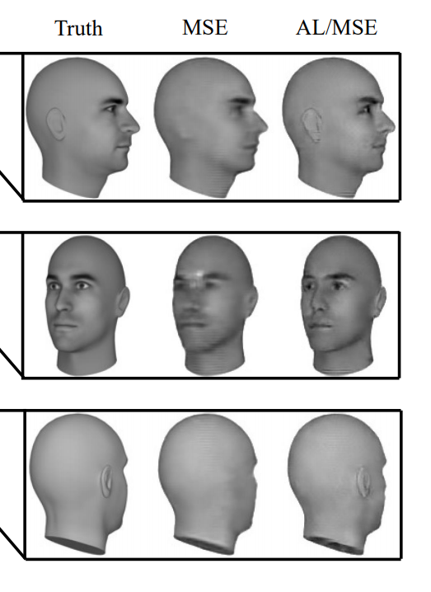
Conditional recurrent GAN

Slide 41
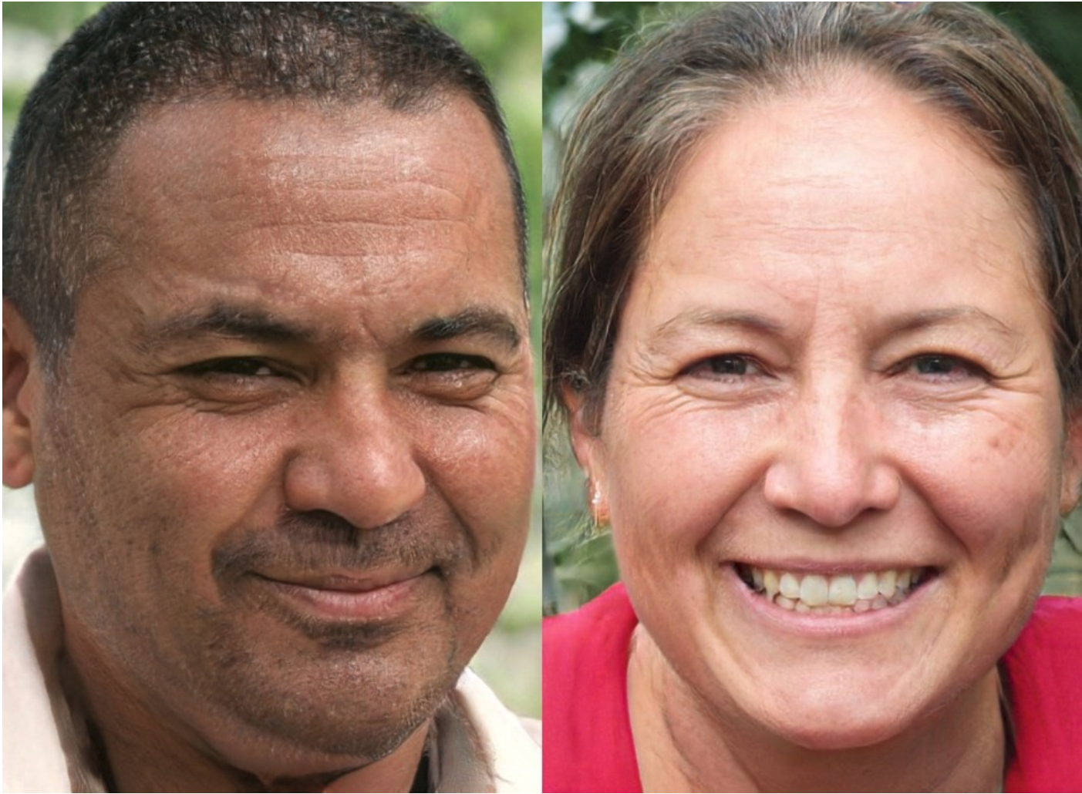
Nvidia's growing GAN: which is fake?
Notes:
https://medium.com/syncedreview/gan-2-0-nvidias-hyperrealistic-face-generator-e3439d33ebaf

Slide 42
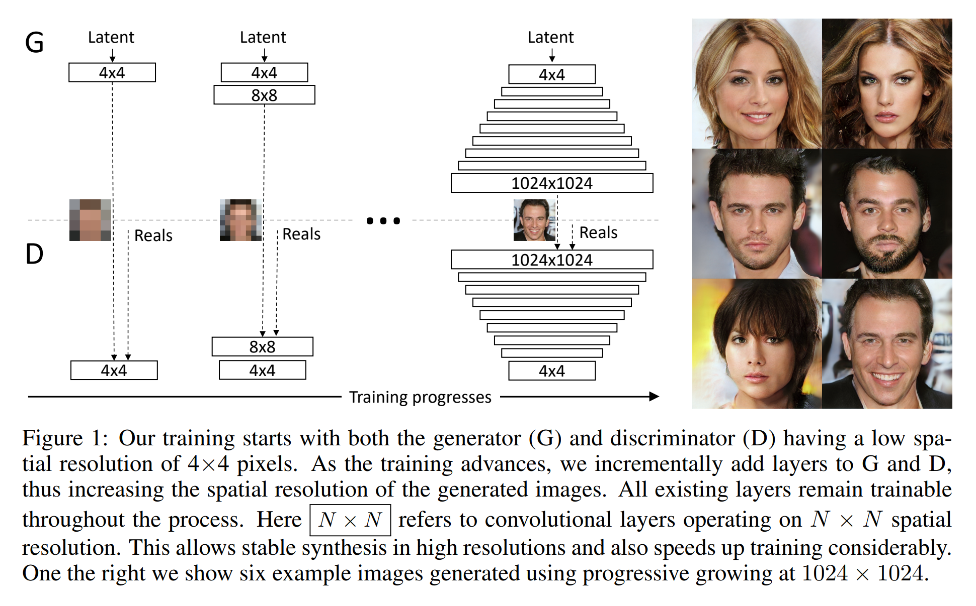
Nvidia's growing GAN: training methodology
https://medium.com/syncedreview/gan-2-0-nvidias-hyperrealistic-face-generator-e3439d33ebaf
Notes:
https://medium.com/syncedreview/gan-2-0-nvidias-hyperrealistic-face-generator-e3439d33ebaf

Slide 43
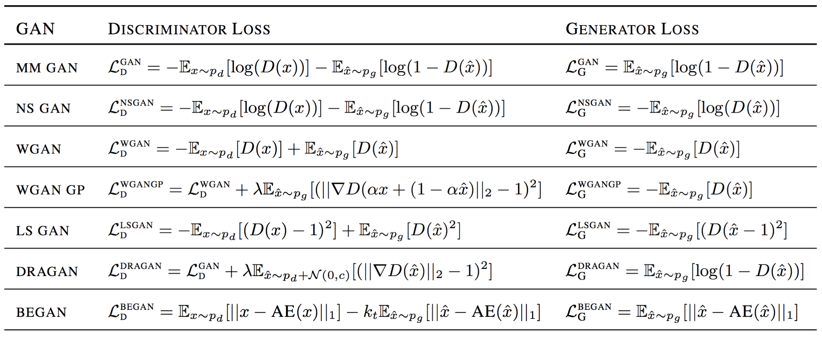
There are so, so many types of GANs

Slide 44
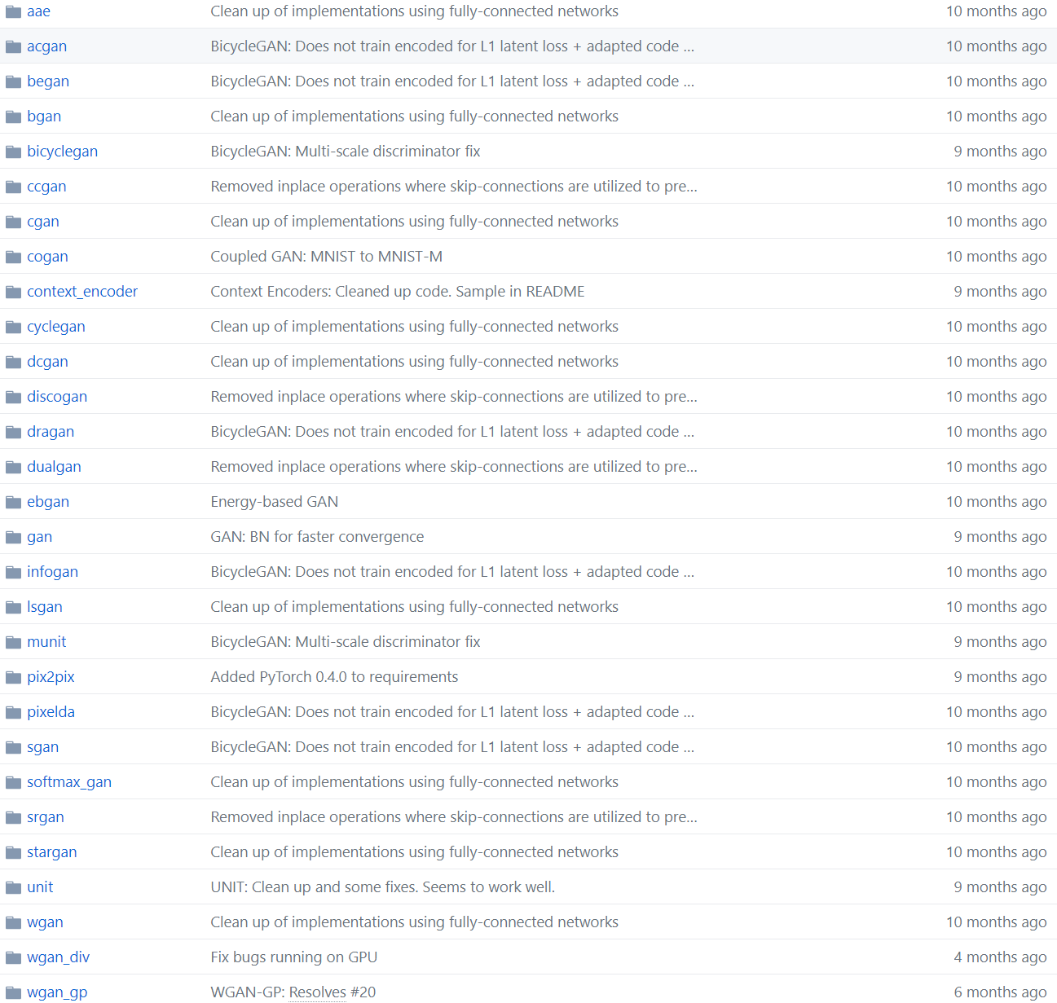
No, really. There are a lot.
https://github.com/eriklindernoren/PyTorch-GAN/tree/master/implementations

Slide 45
Major issues with GANs

Slide 46
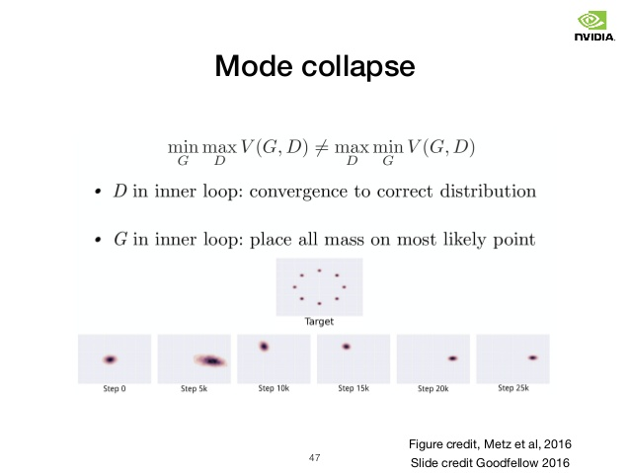
GANs can easily fail to train: mode collapse

Slide 47
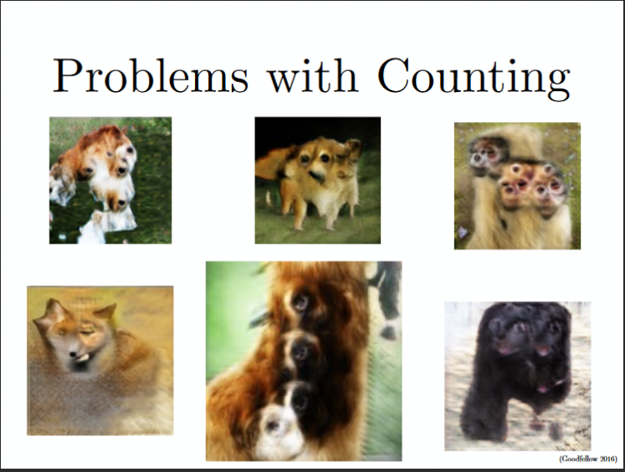
Problems with counting

Slide 48
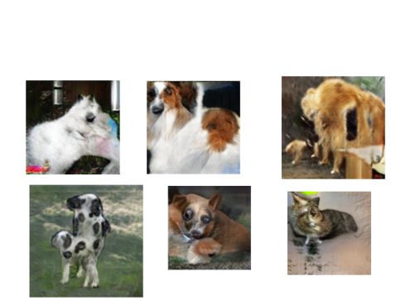
Fallout cow

Slide 49
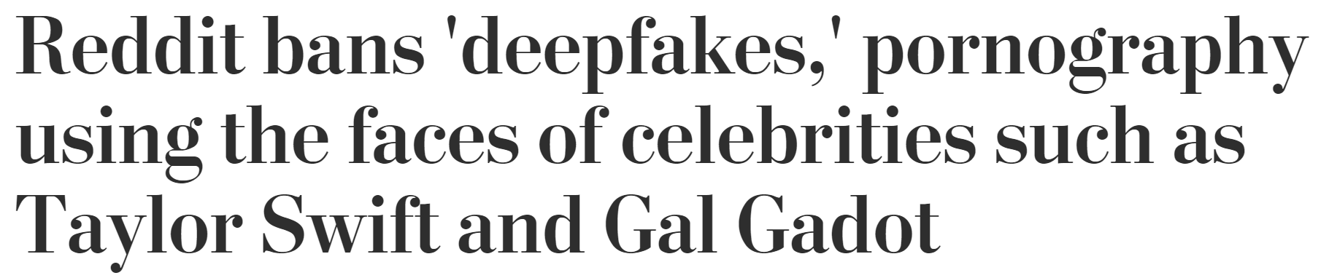
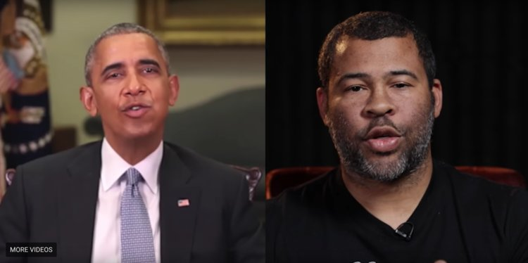
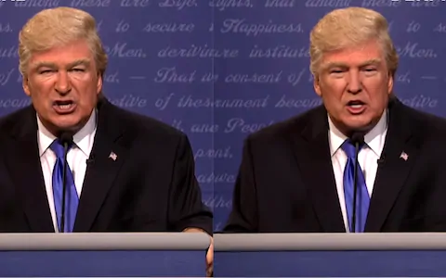
Ethics of being able to create reality-like fiction
“This is a big deal,” Hany Farid, computer science professor at Dartmouth College, told The Wall Street Journal. “You can literally put into a person’s mouth anything you want.”

Slide 50
Looking forward
HW1 due Friday
Keep an eye out for HW2
Start thinking about your project proposal (due Friday, 3/22)
Enjoy spring break!

